Slide 1
Internal Presenter Notes: What Attendees Should Take Away
Content creators: Write 3 things an attendee should take away from the presentation. This will help presenters home in on the main points.
What is Azure
How to Create a VM
Where to go to learn more

Slide 2
Date | By | Slide(s) | Change(s)
2020-02-18 | Frank Boucher | 24, 25 | Fixing Typos
Last time on AFUN95, this was changed

Slide 4
Discovering Microsoft Azure
Christina Warren
Senior Cloud Advocate, Microsoft
@film_girl

Slide 5
Resources
Get Certified
Session Resources
aka.ms/AFUN10
Session Code on GitHub
aka.ms/AFUN10Repo
All Event Resources
aka.ms/mymsignitethetour

Slide 6

What is Azure?
Notes:
Azure is Microsoft’s cloud computing platform. But before we dive into Azure and it’s massive ecosystem of services for your business, let’s talk about cloud computing — what it is and why you should care.

Slide 7

Cloud computing basics
A few terms and concepts we’ll be referencing
Notes:
Before we get into specifics about Azure, let’s go over a few cloud computing terms we’ll be referring to throughout this session

Slide 8
Cloud Computing Types
Infrastructure as a Service (IaaS)
Platform as a Service (PaaS)
Software as a Service (SaaS)
Notes:
Infrastructure as a Service is the most flexible category of cloud services. It aims to give you complete control over the hardware that runs your application. Instead of buying hardware, with IaaS, you rent it.
With great power comes great responsibility
PaaS provides an environment for building, testing, and deploying software applications. The goal of PaaS is to help you create an application as quickly as possible without having to worry about managing the underlying infrastructure. For example, when deploying a web application using PaaS, you don't have to install an operating system, web server, or even system updates.
SaaS is software that is centrally hosted and managed for the end customer. It is usually based on an architecture where one version of the application is used for all customers, and licensed through a monthly or annual subscription. Office 365 is a perfect example of SaaS software.

Slide 9
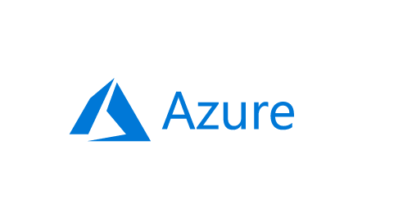
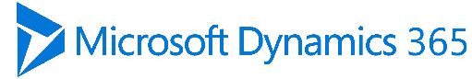


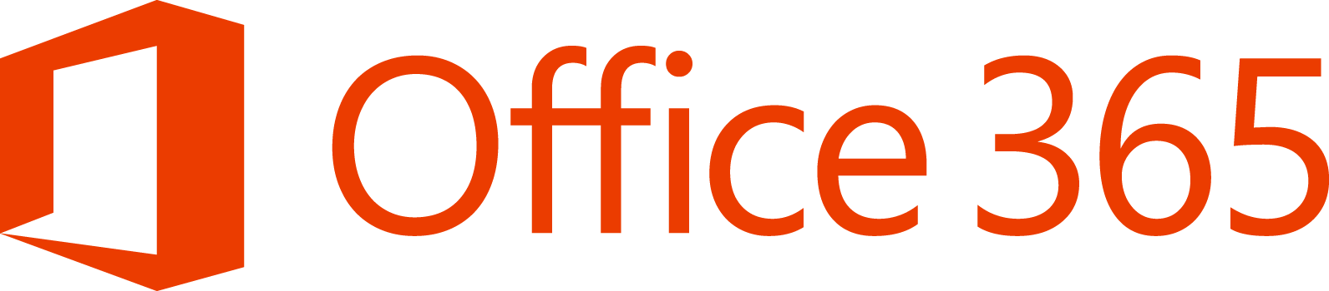
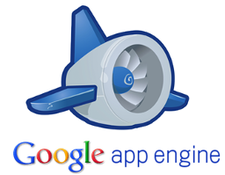


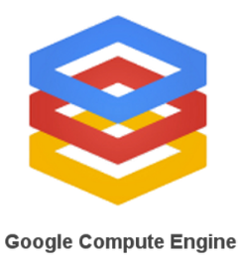
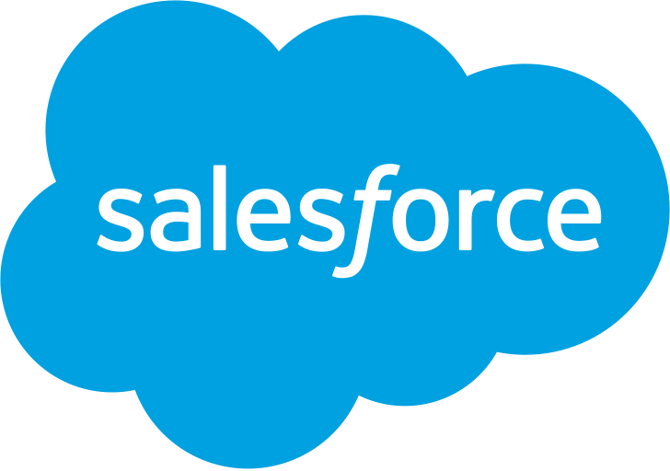
Cloud Service Models
Traditional
on-premises
Infrastructure
(as a Service)
Platform
(as a Service)
Software
(as a Service)
Applications
Applications
Applications
Applications
You manage
Data
Data
Data
Data
Runtime
You manage
Runtime
Runtime
Runtime
Middleware
Middleware
Middleware
Middleware
You manage
O/S
O/S
O/S
Managed by vendor
O/S
Virtualization
Virtualization
Managed by vendor
Virtualization
Virtualization
Servers
Servers
Servers
Servers
Managed by vendor
Storage
Storage
Storage
Storage
Networking
Networking
Networking
Networking
Notes:
Examples of how the provider/vendor breakdown works

Slide 10
The journey to the cloud
App
Migration and modernization
Cloud-native
SaaS
On-premises
Data
Rehost
Refactor
Rearchitect
Rebuild/New
Replace
Infrastructure
Virtual machines
Containers
App, Data, and AI Services
Security and management
Notes:
Rehost: Lift and Shift. Redeploy as-is to cloud; used for quick ROI, freeing up DC space, least effort. IaaS is the key tech here.
Refactor: Minimally alter to take better advantage of cloud; used for code portability and quick updates. Containers and PaaS are the key tech here.
Rearchitect: Materially alter/decompose application to services; to enhance app scale and agility. PaaS, Serverless and Microservices are key tech here.
Rebuild: New code written with cloud native approach; to accelerate innovation and build apps faster. PaaS, Serverless and Microservices are key tech here.

Slide 11
Why move to the cloud?
Cost effective
Pay-as-you-go pricing
Pay only for the resources you use
Notes:
One of the biggest advantages of moving to the cloud is that it’s more cost-effective. Instead of having to pay for all the compute power that you may not always use – you can just pay for what you’re actually using. Say you’re an e-commerce company like Tailwind Traders. A few times a year, like Black Friday and during the holiday season, there might be times when you need more compute resources than usual. In the old system, Tailwind would have to pay for those servers year-round (or manually procure/decommission servers), even if they weren’t using them. With the cloud, they could just pay for the resources they use and expand as needed.

Slide 12
Why move to the cloud?
Cost effective
Pay-as-you-go pricing
Pay only for the resources you use
Scalable
Vertically scale resources
Adding a faster CPU
Adding memory
Horizontally scale
Add more servers

Slide 13
Why move to the cloud?
Cost effective
Pay-as-you-go pricing
Pay only for the resources you use
Scalable
Vertically scale resources
Adding a faster CPU
Adding memory
Horizontally scale
Add more servers
Elastic
Automatically add or remove resources
Add resources when your application is most-heavily used
Remove resources when unnecessary
Notes:
But the best part of this is that the cloud is also elastic. So not only can you scale up and out – but if you do need to contract resources – you can do that too. Tailwind Traders might want to scale out its resources in November and December because of the busy holiday season. But in January, after returns and sales have died down, those extra resources that were added, can be removed.

Slide 14
Why move to the cloud?
Current
Focus on building and deploying applications
Maintenance is done for you
No more software patching, hardware setup, upgrades, and IT management
Notes:
One of the most appealing parts of moving to the cloud – especially public clouds like Azure – is that it allows developers and ops to focus on building and deploying applications. The maintenance work – think patching an operating system or setting up new hardware – is taken care of.

Slide 15
Why move to the cloud?
Current
Focus on building and deploying applications
Maintenance is done for you
No more software patching, hardware setup, upgrades and IT management
Reliable
Your data is safe
Azure provides:
Data backups
Disaster recovery
Data replication
Notes:
The cloud can also offer more reliability because in a managed environment like Azure, you have access to thinks like data backups that can be configured to take snapshot at specific intervals, which can aid with disaster recovery or data replication. SHARE GAWKER STORY ABOUT HURRICANE SANDY

Slide 16
Photo: Iwan Baan/New York Magazine
Notes:
In 2012, a once in a hundred year storm – Hurricane Sandy – hit Manhattan. The lower half of the Island lost power and went dark.
This included data centers for companies like Squarespace and major websites like Gawker and BuzzFeed and the Huffington Post. Teams scrambled to either move infrastructure backups to alternative locations and in some cases, carried buckets of gasoline up the steps of the data center to feed the generators to get things back online.
This was in an area that businesses felt safe having their data centers – how often does a hurricane hit New York City?
The cloud offers not just more reliability with where you store your data – but you can opt to have data stored multiple places, just in case the unthinkable happens.

Slide 17
Why move to the cloud?
Current
Focus on building and deploying applications
Maintenance is done for you
No more software patching, hardware setup, upgrades and IT management
Reliable
Your data is safe
Azure provides:
Data backups
Disaster recovery
Data replication
Secure
Physical security
Digital security
Notes:
Physical security: walls, cameras, gates, security personnel, etc.
Digital security: Data can travel in many ways within a data center, between data centers and over the internet.
That said, moving to the cloud doesn’t mean you don’t need to worry about security – it just means that security approaches may be different. Be sure to check out our session on cloud security.

Slide 18
/Upcoming Session alert
AFUN40: Azure Security Fundamentals
Wednesday 15:15 – 16:00 Paris South

Slide 19

What is Azure?
Notes:
Now that we’ve covered the advantages of moving to the cloud, let’s talk more about Azure specifically.

Slide 20




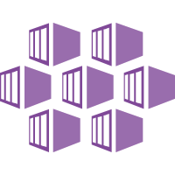

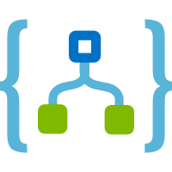

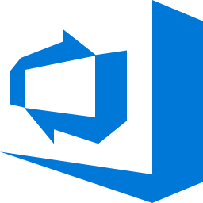
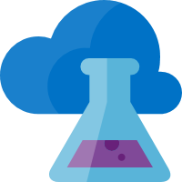
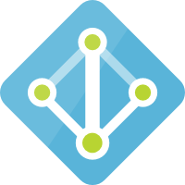

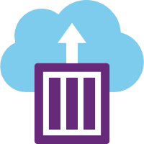
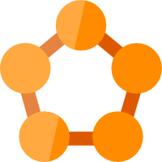




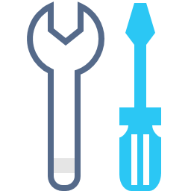

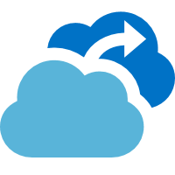



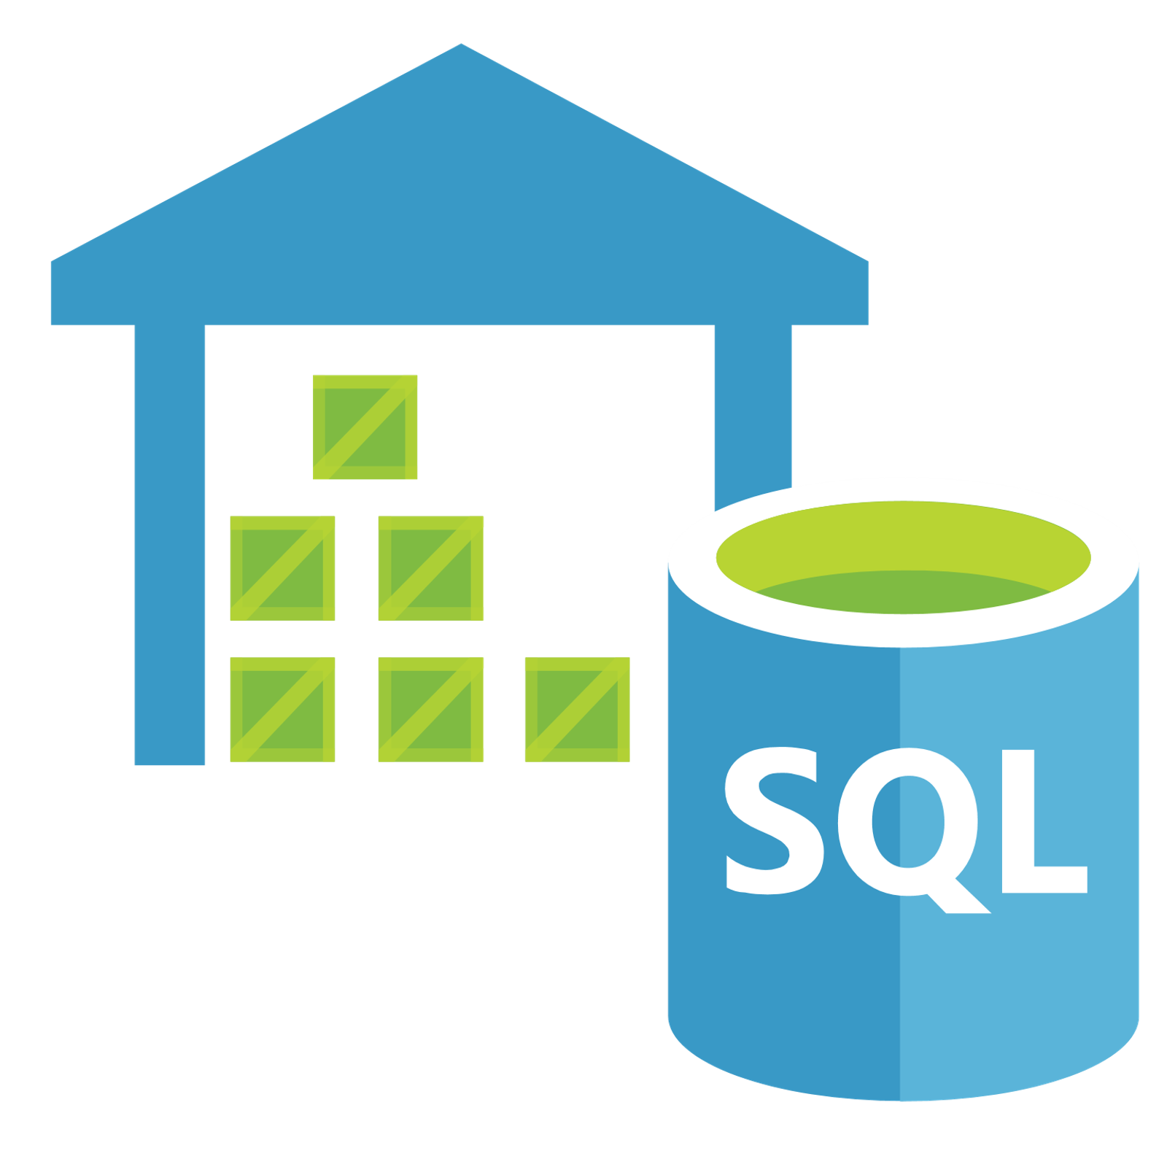
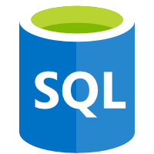

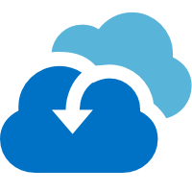

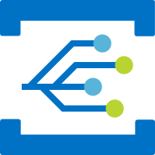



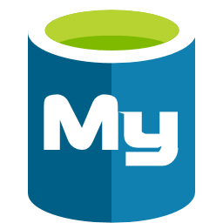


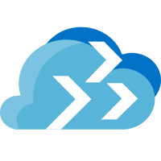





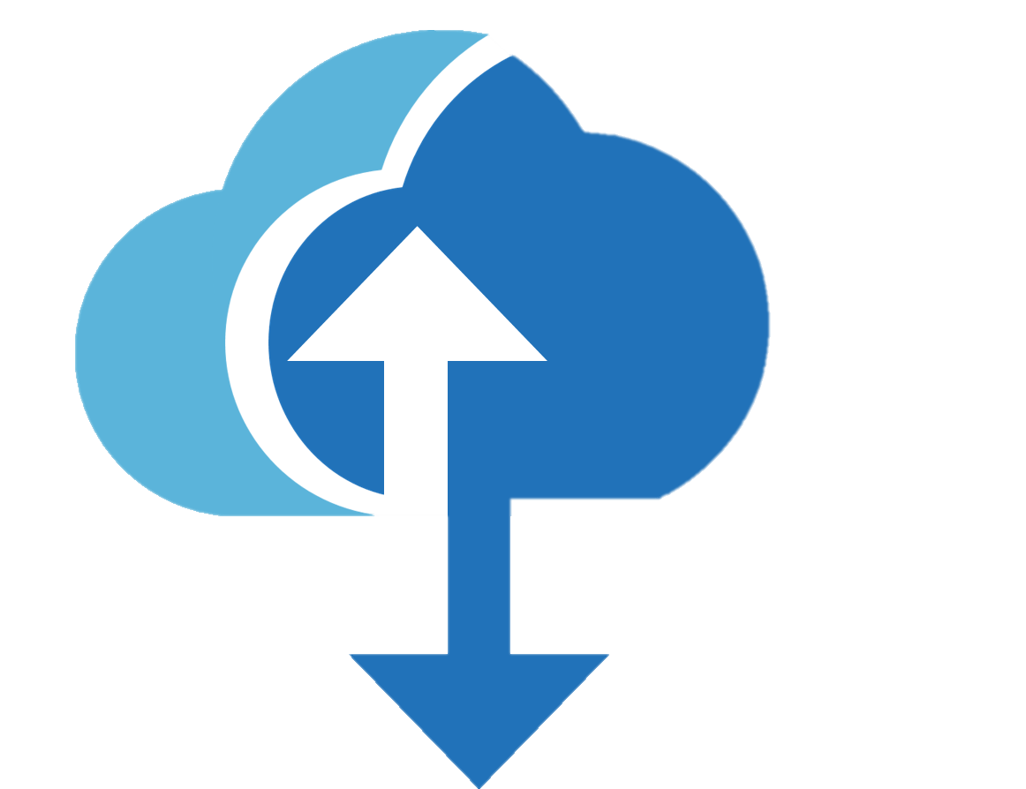


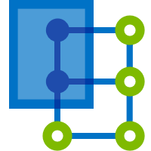



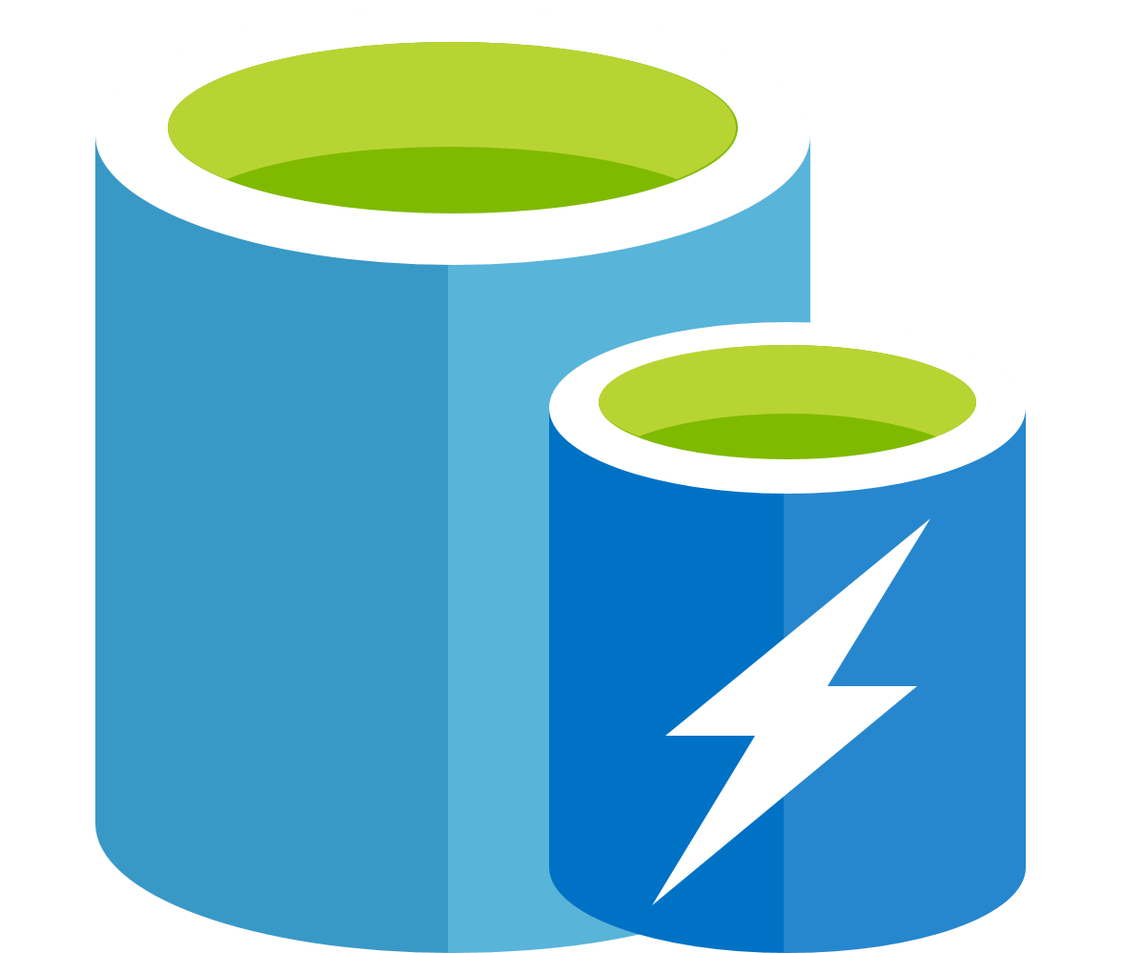



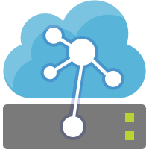



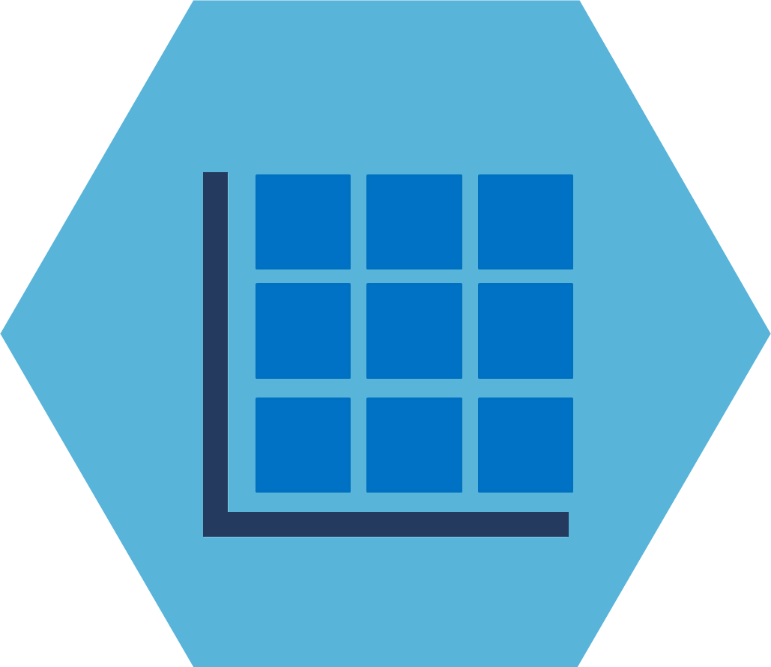

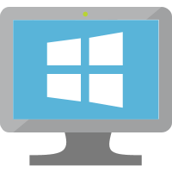

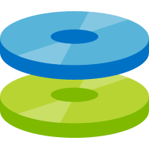
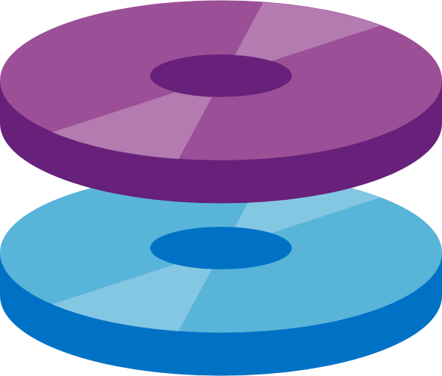
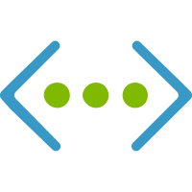

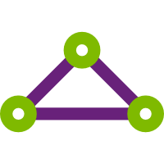

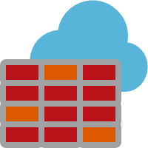
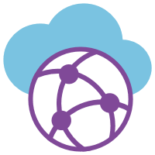


What is Azure?
Management
Platform as a Services (PaaS)
Security
Azure
Monitor
Compute/Containers
Web/Mobile
DevOps/Developer
Security
Center
Log
Analytics
Functions
Kubernetes
Service
Web Apps
Logic Apps
API Apps
Azure DevOps
Lab
Services
Azure AD
Azure
Policy
Container
Instance
Service Fabric
Mobile Apps
Notification
Hubs
SignalR
Service
Application
Insights
SDK
Azure AD for
Domain Services
Azure
Bluepirnts
Integration
IoT
AI
Analytics
Data Services
Azure AD
B2C
Azure
Backup
API
Management
Logic Apps
IoT Hub
Cognitive
Services
SQL Data
Warehouse
SQL
Database
SQL Data
Warehouse
DDoS
Protection
Site
Recovery
Service Bus
Event Grid
IoT Central
Machine
Learning Studio
Azure
Databricks
Database for
MySQL
Cosmos DB
Key Vault
Azure
Migrate
Media/CDN
Time Series
Insights
Machine
Learning Service
Apache Spark
Database for
PostgreSQL
Data Factory
Multi-Factor
Authentication
Databox
Family
Media Services
Content
Protection
Azure
Digital Twins
Bot
Services
Stream
Analytics
Database for
MariaDB
Azure Cache
for Redis
Azure ATP
Cost
Management
Video Indexer
Content Delivery
Network
IoT Edge
Azure
Search
Data Lake
Storage Gen2
Database
Migration Service
Table
Storage
Role- based
access control
Infrastructure as a Services (IaaS)
Compute
Storage
Networking
Virtual
Machine Scale Sets
Linux
Virtual
Machine
Disk Storage
Managed
Disks
Virtual
Network
VPN
Gateway
Express
Route
Load
Balancer
Azure
Firewall
Virtual
WAN
Network
Watcher
Azure Datacenter Infrastructure
Notes:
Now that we’ve covered the basics of moving to the cloud, let’s talk more about Azure specifically.

Slide 21
Azure is secure, cost-effective, and ubiquitous
Compute
Networking
Storage
Security and management
Notes:
Generally, the services provided by Azure are categorized as compute, networking and storage.
Every service can be secured and managed easily from the platform.

Slide 22
Azure compute services
Azure Virtual machines
Windows or Linux VMs
Azure Kubernetes service
Manage clusters of VMs that run containerized services
Azure Functions
Event-driven, serverless computing

Slide 23
Azure networking services
Azure Virtual Network
Connects VMs to VPN connections
Azure Load Balancer
Balances inbound and outbound connections
Azure Traffic Manager
Distributes network traffic across Azure regions

Slide 24
Azure storage services
Azure blob storage
Stores objects like video files, JSON, images, IoT data
Azure file storage
Acts as a file server to share and access files
Azure table storage
NoSQL storage for structured data
Notes:
Generally, the services provided by Azure are categorized as compute, networking and storage.
Every service can be secured and managed easily from the platform.

Slide 25
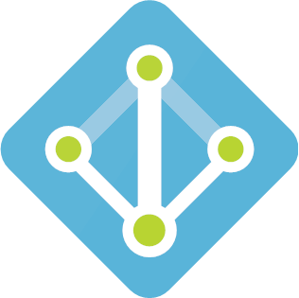
What is Azure Active Directory?
Azure AD is a multi-tenant, cloud-based directory and identity management service
Notes:
Azure Active Directory (Azure AD) is Microsoft’s multi-tenant, cloud based directory and identity management service.

Slide 26
What is Azure Active Directory?
What is Azure Active Directory?
Centralized directory store
Used by Azure and Office 365
Contains all the identities of users in your organization
Notes:
Azure AD is the centralised directory store used by Azure and Office 365, containing all the identities of users inside your organisation.

Slide 27
/Upcoming Session alert
AFUN90: Azure Identity Fundamentals
Thursday 15:15 – 16:00 Paris South

Slide 28
Explore the Azure Portal
aka.ms/azure-portal
Notes:
Demo Azure portal, blades and cloud shell

Slide 29

Azure Resource Manager
ARM and ARM Templates
Notes:
No matter how you use Azure, you’ll most likely have multiple components to manage. Virtual machines, storage accounts, virtual networks, web apps, databases, third party services… there’s a lot to keep track of.
This is where Azure Resource Manager comes in handy. ARM

Slide 30
Azure Resource Manager
How the Azure Resource Manager Works
Notes:
You don't see these components as separate entities, instead you see them as related and interdependent parts of a single entity. You want to deploy, manage, and monitor them as a group. Azure Resource Manager enables you to work with the resources in your solution as a group.

Slide 31
Azure Resource Manager
Consistent management layer
See components as related and independent parts of your network
Deploy, manage, and monitor resources as a group
Provides security, auditing, and tagging
Notes:
Resource Manager provides a consistent management layer available in the Azure portal as well as Azure PowerShell, Azure CLI, Azure REST APIs and client SDKs.
It provides security, auditing, and tagging features to help you manage your resources after deployment.

Slide 32
Azure Resource Manager
Resource
A manageable item available through Azure. VMs, web apps, databases, etc.
Notes:
There’s some basic terminology you’ll want to be familiar with before diving into ARM.

Slide 33
Azure Resource Manager
Resource
A manageable item available through Azure. VMs, web apps, databases, etc.
Resource group
A container that holds related resources
You decide how to allocate resources to groups

Slide 34
Subscriptions, resource groups, and resources
Subscription
Resource Group
Resource Group
Resource Group

Slide 35
Azure resource manager
Resource
A manageable item available through Azure. VMs, web apps, databases, etc.
Resource group
A container that holds related resources
You decide how to allocate resources to groups
Resource provider
A service that supplies the resources you can deploy and manage

Slide 36
Common resource providers
Microsoft.Compute
Supplies the VM resource
Microsoft.Storage
Supplies the storage account resource
Microsoft.Web
Supplies resources related to web applications

Slide 37
Azure Resource Manager
Resource
A manageable item available through Azure. VMs, web apps, databases, etc.
Resource group
A container that holds related resources
You decide how to allocate resources to groups
Resource provider
A service that supplies the resources you can deploy and manage
Resource manager template
A JSON file that defines resources to deploy to a resource group
Defines dependencies between resources

Slide 38
Azure Resource Manager Template
azuredeploy.json
},
"resources": [
{
"type": "Microsoft.Storage/storageAccounts",
"apiVersion": "2018-11-01",
"name": "[variables('storageAccountName')]",
"location": "[parameters('location')]",
"sku": {
"name": "[variables('storageAccountType')]"
},
"kind": "Storage",
"properties": {}
},
A JSON file that defines resources to deploy to a resource group
Defines dependencies between resources

Slide 39
/Upcoming Session alert
AFUN30: Discovering Azure Tooling and Utilities
Wednesday 14:00 – 14:45 Paris South

Slide 40

Azure compute options
Virtual machines and containers

Slide 41
Compute Options
Intel Haswell E5-2673 v3
Lowest cost, flexible CPUs
Up to 8vCPUs, 32GB RAM
Intel® Xeon® Platinum 8168 processor (Skylake)
Entry level
Burstable
General purpose
Compute intensive
Storage optimized
A
Av2
B
D
Dv2
Dv3
F
Fv2
L
Lv2
Intel Broadwell E5-2673 v4
Hyper-Threaded CPUs
Up to 64 vCPU’s, 256GB RAM
Notes:
What you really need to know is that no matter what your needs are, Azure has you covered.

Slide 42
Compute options
Intel Xeon E5-2673 v4 (Broadwell)
Hyper-Threaded CPUs
Up to 64 vCPUs, 432GB RAM
Nvidia M60
High Performance Computing
Memory Optimized
Graphics Intensive
Purpose-built SAP HANA
G
Ev3
M
NC
NCv2
NV
ND
H
HANA
NCv3
NVv2
NDv2
Hv2
Intel Xeon E7-8890 v3 (Haswell)
Largest VMs in Azure
Up to 128 vCPUs, 4TB RAM
V100 PCIe
Nvidia V100 SXM GPU
Infiniband networking
Deep learning, AI
Skylake Processor
Notes:
What you really need to know is that no matter what your needs are, Azure has you covered.

Slide 43
What’s a Virtual Machine (VM)?
Software emulation of a physical computer
Includes:
Virtual processor
Memory
Storage
Networking resources
Unlike containers, VMs host an OS
Notes:
Virtual machines, or VMs, are software emulations of physical computers. They include a virtual processor, memory, storage, and networking resources. They host an operating system, and you're able to install and run software just like a physical computer. And by using a remote desktop client, you can use and control the virtual machine as if you were sitting in front it.

Slide 44
Creating a VM in Azure
Takes 5 minutes
Select a pre-configured VM image
A template used to create a VM
Includes an OS and usually some other software
Notes:
Virtual machines in Azure
Virtual machines can be created and hosted in Azure. Typically, new virtual machines can be created and provisioned in minutes by selecting a pre-configured virtual machine image.

Slide 45
What’s a container?
Containers = operating system virtualization
Traditional virtual machines = hardware virtualization
OS
Application
VM
VM
VM
Applications
Container
Container
Container
App
App
App
Kernel
OS
OS
OS
OS
Hardware
Hardware
Windows Server containers: maximum speed and density
Hyper-V containers: isolation plus performance
Container
Container
Container
Container
Container
Container
Kernel
Kernel
Kernel
Hardware
Hyper-V
Notes:
Containers are a virtualization environment but, unlike a virtual machine, they do not include an operating system. Instead, they reference the operating system of the host environment that runs the container.
In contrast to VMs, all that a container requires is enough of an operating system, supporting programs and libraries, and system resources to run a specific program. What this means in practice is you can put two to three times as many as applications on a single server with containers than you can with a VM. In addition, with containers you can create a portable, consistent operating environment for development, testing, and deployment.

Slide 46
Virtualization vs. containerization
Virtual machine
Container
Application XYZ
Application
App dependencies
Dependencies
Guest OS
C
C
C
C
C
VM
VM
VM
VM
VM
VM
Dependency 1
Dependency 2
Hypervisor 2
Docker Engine
Hypervisor 1
Host OS
Host OS
Hardware
Hardware
Hardware
Type 1
Type 2
Virtualization
Containerization
Notes:
Containers are a virtualization environment but, unlike a virtual machine, they do not include an operating system. Instead, they reference the operating system of the host environment that runs the container.
In contrast to VMs, all that a container requires is enough of an operating system, supporting programs and libraries, and system resources to run a specific program. What this means in practice is you can put two to three times as many as applications on a single server with containers than you can with a VM. In addition, with containers you can create a portable, consistent operating environment for development, testing, and deployment.

Slide 47
The container advantage
Traditional virtualized environment
Low utilization of container resources
VM
VM
Containerization of applications and their dependencies
Application
Con.
Con.
Application
Con.
Con.
Hypervisor 2
Host OS
Hardware
Notes:
For example, if five containers are running on a server with a specific Linux kernel, all five containers are running on that same kernel.
The following illustration shows a comparison between applications running directly on a VM and applications running inside containers on a VM.

Slide 48
/Upcoming Session alert
AFUN60: Exploring Containers and Orchestration in Azure
Thursday 11:00 – 11:45 Paris South

Slide 49
Create a virtual machine
Christina Warren

Slide 50

Azure compute options
Serverless, Azure Functions, Azure App Service

Slide 51
What is Serverless?
Actually, there are a lot of servers
Someone else’s servers
You don’t have to manage infrastructure
Notes:
Serverless computing is a cloud-hosted execution environment that runs your code but completely abstracts the underlying hosting environment. You create an instance of the service, and you add your code; no infrastructure configuration or maintenance is required, or even allowed.

Slide 52
What is Serverless?
Abstraction of servers, infrastructure and operating systems
Event-driven
Fully-managed
Server management based on resources consumed
Capacity planning based on time code is running
Notes:
Serverless computing is a cloud-hosted execution environment that runs your code but completely abstracts the underlying hosting environment. You create an instance of the service, and you add your code; no infrastructure configuration or maintenance is required, or even allowed.

Slide 53
Serverless in Azure
Power Automate (Formerly Microsoft Flow)
Built on Logic Apps
Create simple integrations
Designed for non-tech employees
Azure Logic Apps
Advanced Flow for developers, operations folks and IT pros
Azure Functions
Serverless compute service
Runs locally and in the cloud
Azure App Service Webjobs
Run scripts in the context of an App Service
Notes:
There are 4 main serverless services in Azure.

Slide 54
Azure Functions
Small pieces of code, easy to run
Develop serverless applications on Azure
Pay only for the time your code runs
Use your development language of choice
Supported languages: C#, JavaScript, F#, Java, TypeScript
Simplify integration with Azure services
Functions runtime is opensource
Notes:
Functions and Logic Apps are Azure services that enable serverless workloads. Azure Functions is a serverless compute service, while Azure Logic Apps provides serverless workflows. Complex orchestrations can be created by both. An orchestration is a collection of functions or steps, called actions in Logic Apps, that are executed to accomplish a complex task. For example, to process a batch of orders you might execute many instances of a function in parallel, wait for all instances to finish, and then execute a function that computes a result on the aggregate.

Slide 55
Azure App Service
Build and host web apps in your language of choice
Auto-scaling and high availability
Automated deployments from GitHub and Azure DevOps
Quickstarts
.NET Core
PHP
Node.js
Java
Python
Ruby
Docker
Notes:
I want to touch on one more compute option – and that’s Azure App Service, which runs on both Windows and Linux – and takes advantage of containers.
Azure Web Apps enables you to build and host web applications in the programming language of your choice without managing infrastructure. It offers auto-scaling and high availability, supports both Windows and Linux, and enables automated deployments from GitHub, Azure DevOps, or any Git repo.

Slide 56
Azure App Service
Windows or Linux
Web App or Web App for Containers
VS Code Extension
Notes:
I want to touch on one more compute option – and that’s Azure App Service, which runs on both Windows and Linux – and takes advantage of containers.
Azure Web Apps enables you to build and host web applications in the programming language of your choice without managing infrastructure. It offers auto-scaling and high availability, supports both Windows and Linux, and enables automated deployments from GitHub, Azure DevOps, or any Git repo.

Slide 57
/Upcoming Session alert
AFUN95: Figuring Out Azure Functions
Thursday 16:30 – 17:15 Paris South

Slide 58
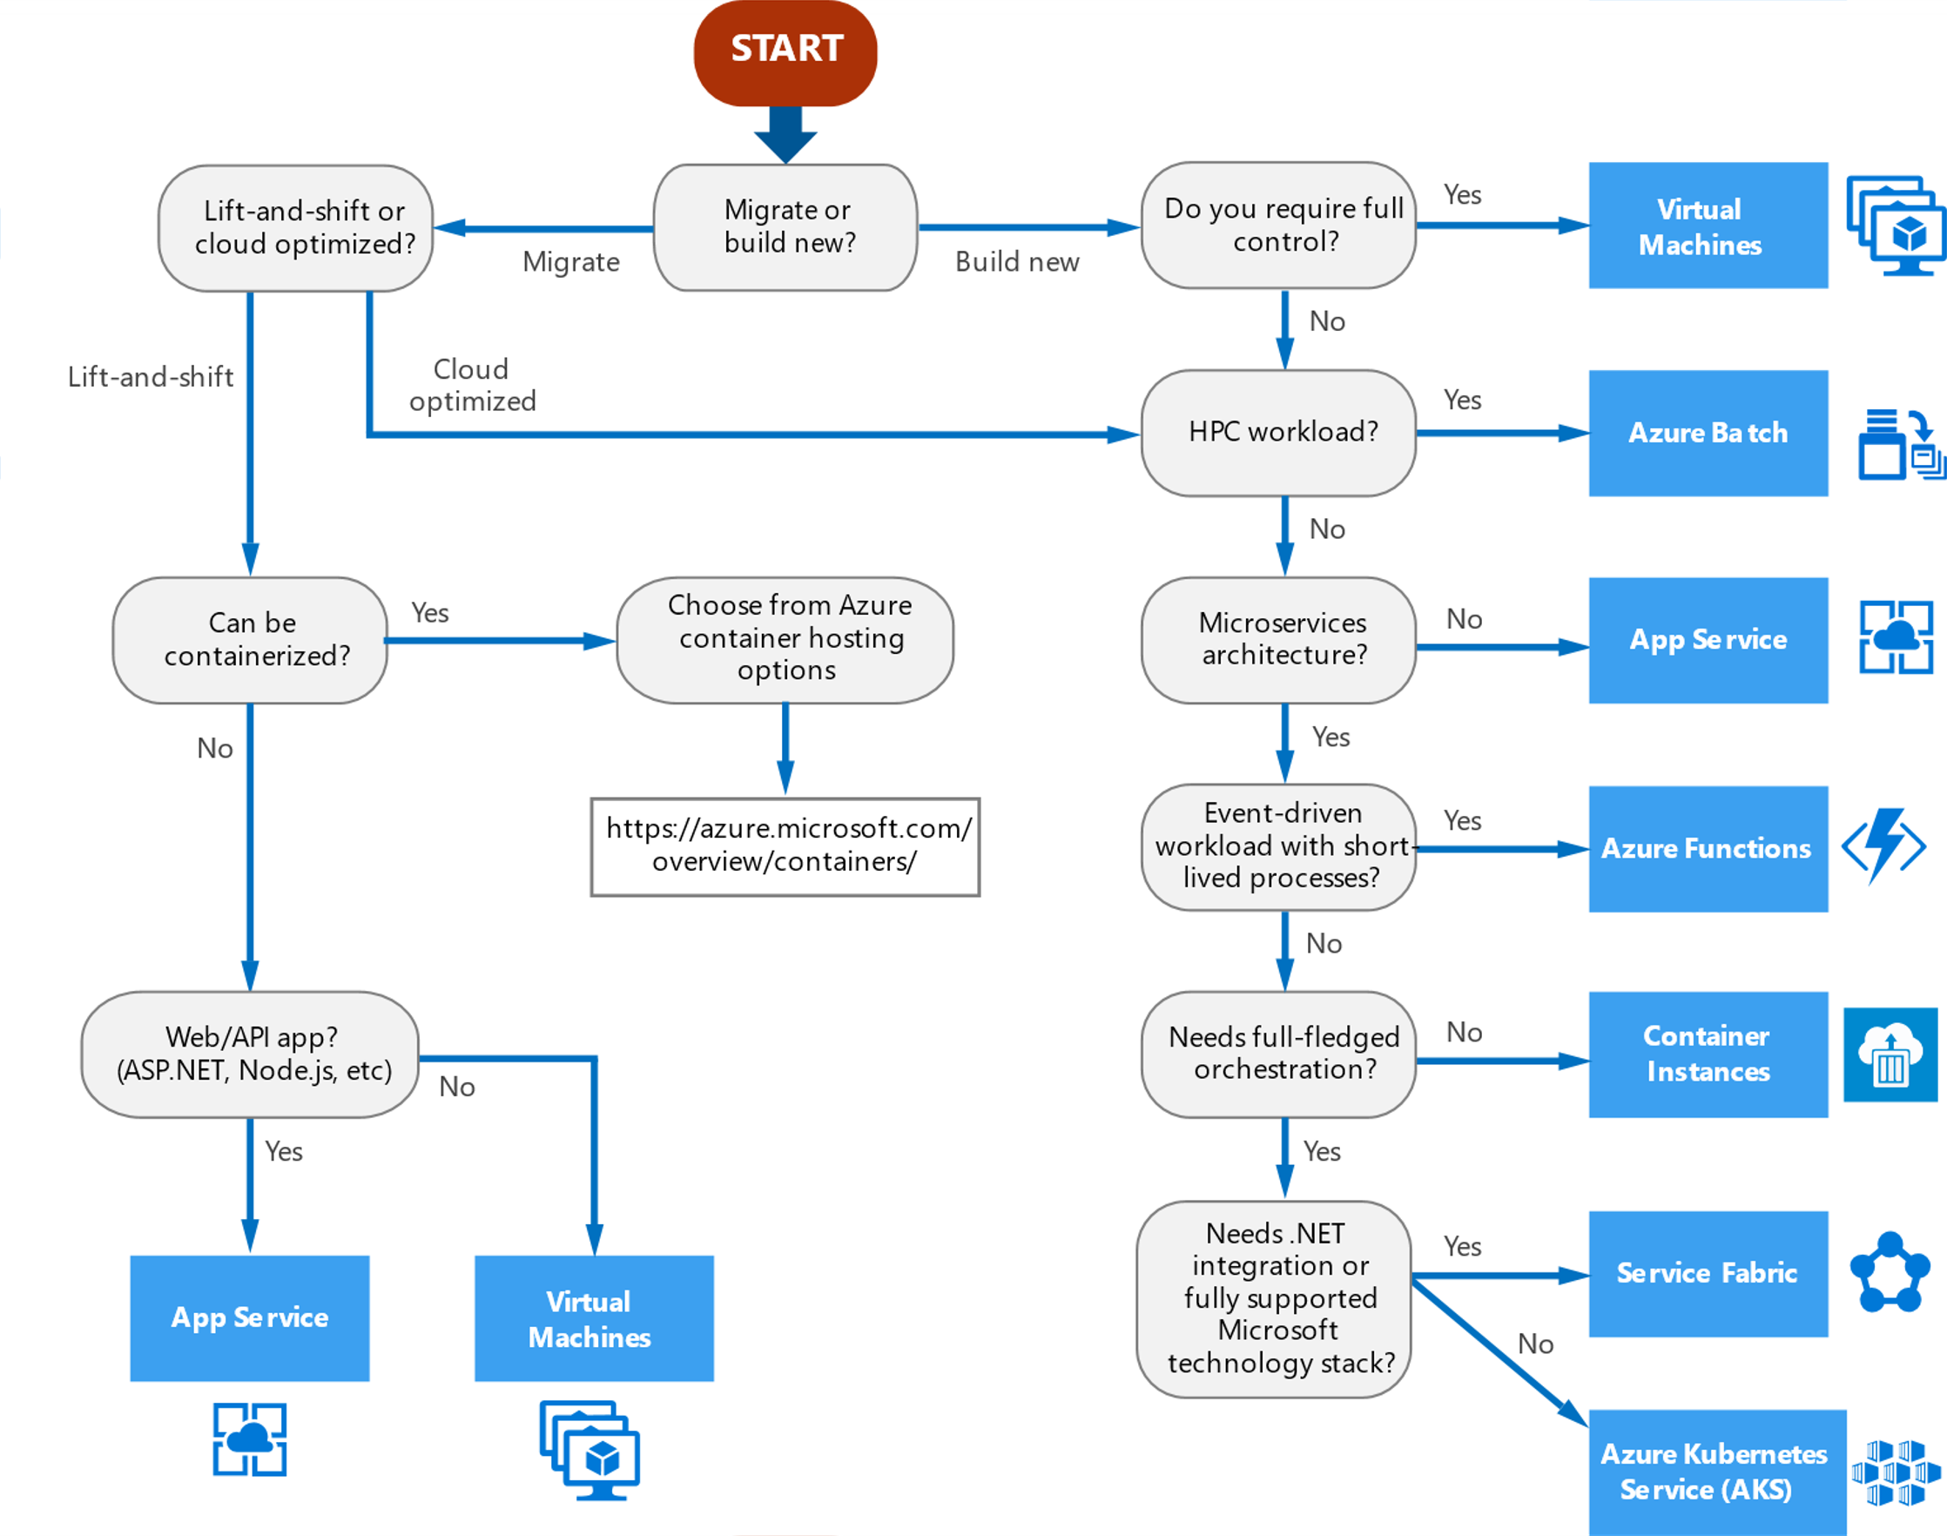
Compute service decision tree
Notes:
This offers up a brief overview of what options/decisions you might make

Slide 59

/Microsoft Certification alert
Microsoft Certified: Azure Fundamentals
aka.ms/AzureFunCert
Get hired, stay ahead, and receive the recognition you deserve
#MSIgniteTheTour
Notes:
Learning this material is a big step toward becoming Microsoft Certified. Microsoft has certification paths for many technical job roles and it shows that you are keeping pace with today’s technical roles and requirements. Check out these related certifications and gain a new professional edge.

Slide 60
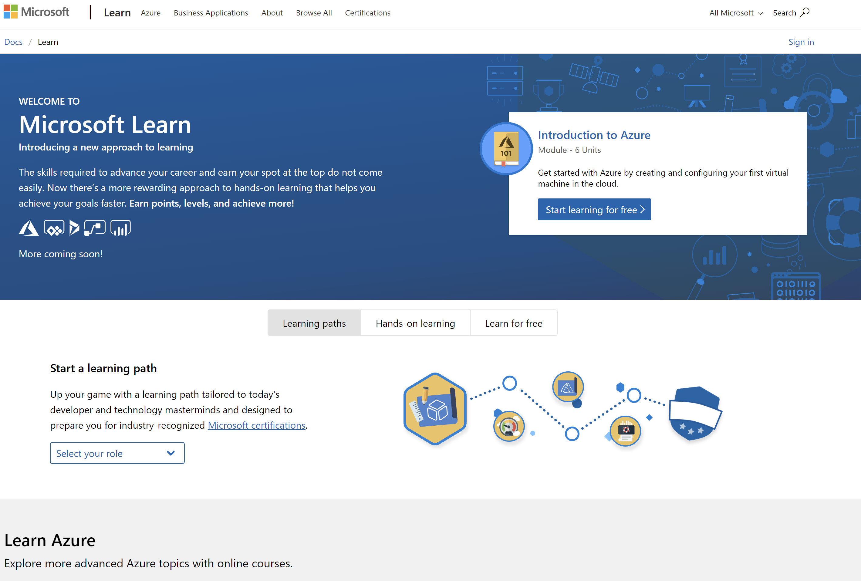
/MS Learn alert
Complete interactive learning exercises, watch videos, and practice and apply your new skills.
aka.ms/AFUN10MSLearnCollection

Slide 61

Exclusive offer for Microsoft Ignite The Tour attendees
Now is your chance to stand out among your peers.
Get certified and prove your expertise to employers and peers and get the recognition and opportunities you've earned. Take advantage of this offer by scheduling a free exam online today.
Free Certification Exam
on fundamentals, role-based, or specialty certifications*
Learn more about Microsoft Certifications Microsoft.com/Certifications
aka.ms/FreeExam_MSIgnite
Begin with free online training Microsoft.com/Learn
Limited to one (1) per attendee. Subject to terms and conditions. Please see website for details.
*Free exams include only those with the following prefixes: AI, AZ, DP, MB, MD, MS, and PL
Find a Learning Partner to help you prepare aka.ms/LearningPartner
Notes:
For the first time, Microsoft is offering FREE certification exams to all event attendees. You can take advantage of this for any Fundamentals or Role-based Certifications.
The offer is for one free exam and it’s valid for up to 6 months post-event.
You can utilize this at our onsite testing in the event expo hall or use it post-event using the same email address used to sign up for the event. (Gov. Officials are not eligible)
Expect an email with deails after the show for those of you who have opted-in to receive promotional email from Microsoft.

Slide 62
Resources
Get Certified
Session Resources
aka.ms/AFUN10
You’re on your way to being certified!
Session Code on GitHub
Azure Fundamentals: aka.ms/AzureFunCert
aka.ms/AFUN10Repo
aka.ms/app10certification
All Event Resources
aka.ms/mymsignitethetour
#MSIgniteTheTour

Slide 63
Invent with purpose.
Notes:
And that’s a statement around how we feel about Azure.
We want to invent with purpose in how we think about it what we deliver to you but also enable you to invent with purpose.
And we do that in some key ways.
TRANSITION: I talk about these ways as our promises to you on what Azure will always deliver and why we’ll help you.

